Slide 1
Image processing
معالجه صور

Slide 2
Introduction image processing

Slide 3
“One picture is worth more than ten thousand words”
Anonymous

Slide 4
Image Processing , Image Analysis , Image Understanding
Image Processing
image in →image out
Image Analysis
image in →measurements out
Image Understanding
image in →high-level description out

Slide 5
Environment
Acquisition
Filter
Segmentation
Enhancement
Report

Slide 6
Environment
Filed
Electronic spectrum
sound
Media
Indoor
Outdoor
Under water
Coordinate
الاسقاط(ثنائي ,ثلاثي)

Slide 7
What Is An image ?
An image is a two-dimensional function, f(x,y), where x and y are spatial (plane) coordinates, and the amplitude of f(x,y) at any pair of coordinates (x, y) is called the intensity or gray level of the image at the point (x,y).
Note: When x, y, and the amplitude values of f are all finite, discrete quantities, we call the image a digital image.

Slide 8
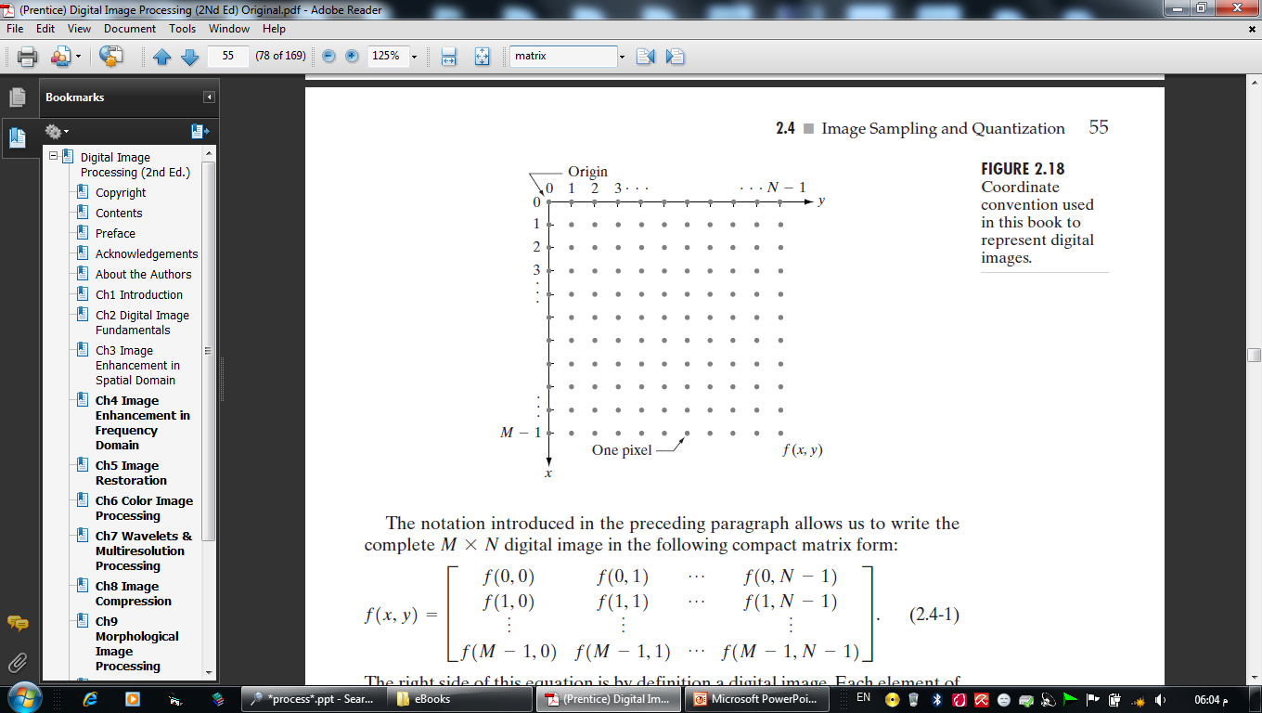
What Is A digital Image ?
A digital image is a two-dimensional matrix, f(M,N), where the value at the location (x,y) is called the intensity or gray level of the image at the point (x,y).
So, the digital image is composed of a finite number of elements, each of which has a particular location and value.
The digital image elements are referred to pels, and pixel

Slide 9
What Is A digital Image ?
الصورة الرقمية عبارة عن مصفوفة ثنائية الأبعاد ، f(M,N), حيث تسمى القيمة في الموقع (x,y) الكثافة أو المستوى الرمادي للصورة عند النقطة (x,y).
لذلك ، تتكون الصورة الرقمية من عدد محدود من العناصر ، لكل منها موقع وقيمة معينة.

Slide 10
What Is A digital Image ?

Slide 11
Image Sampling and Quantization
An image may be continuous with respect to the x- and y-coordinates, and also in amplitude. To convert it to digital form, we have to sample the function in both coordinates and in amplitude.
Digitizing the coordinate values is called sampling.
Digitizing the amplitude values is called quantization.
How do we get a clearer picture?

Slide 12
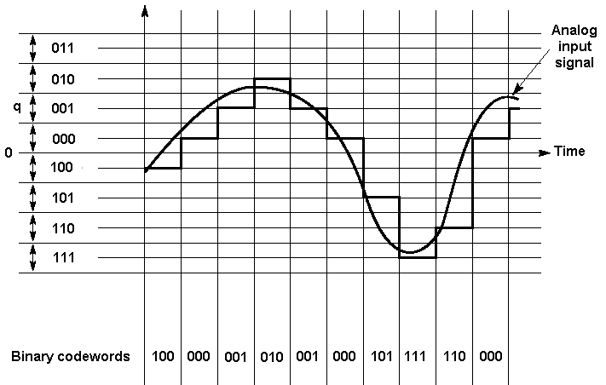
Sampling , quantization

Slide 13
What Is A digital Image ?

Slide 14
What Is A digital Image ?

Slide 15
What Is Digital Image Processing?
Digital image processing field, is a preprocessing step for other computerized processing fields such as computer vision and pattern recognition.
In computer vision, the goal is to use computers to emulate human vision, including learning (understanding) and being able to make inferences and take actions based on visual inputs.
مجال معالجة الصور الرقمية ، هو خطوة معالجة مسبقة لمجالات المعالجة المحوسبة الأخرى مثل رؤية الكمبيوتر والتعرف على الأنماط.
في رؤية الكمبيوتر ، الهدف هو استخدام أجهزة الكمبيوتر لمحاكاة الرؤية البشرية ، بما في ذلك التعلم (الفهم) والقدرة على عمل الاستنتاجات واتخاذ الإجراءات بناءً على المدخلات المرئية.

Slide 16
Applications of Digital Image Processing
Image sharpening and restoration
It refers to the process in which we can modify the look and feel of an image. It basically manipulates the images and achieves the desired output. It includes conversion, sharpening, blurring, detecting edges, retrieval, and recognition of images.
2) Medical field
There are several applications under medical field which depends on the functioning of digital image processing .Gamma-ray imaging,X-Ray Imaging,Medical CT scan ,UV imaging
3) Robot vision
There are several robotic machines which work on the digital image processing. Through image processing technique robot finds their ways, for example, hurdle detection root and line follower robot.

Slide 19
Applications of Digital Image Processing
4) Pattern recognition
It involves the study of image processing, it is also combined with artificial intelligence such that computer-aided diagnosis, handwriting recognition and image recognition can be easily implemented. Now a days, image processing is used for pattern recognition.
5)Video processing
It is also one of the applications of digital image processing. A collection of frames or pictures are arranged in such a way that it makes the fast movement of pictures. It involves frame rate conversion, motion detection, noise reduction and color space conversion etc.

Slide 20
Cont.,
There are no clear-cut boundaries in the continuum from image processing at one end to computer vision at the other.
So, we can consider three types of computerized processes in this continuum: low-, mid-, and high-level processes.
Low-Level
Mid-Level
High-Level

Slide 21
Cont.,
Low-level processes involve primitive operations such as noise reducing, contrast enhancement, and image sharpening.
Mid-level processing on images involves tasks such as segmentation, description of those objects to reduce them to a form suitable for computer processing.
Higher-level processing involves “making sense” of an ensemble of recognized objects, as in image analysis, and, at the far end of the continuum, performing the cognitive functions.
Thus, digital image processing encompasses processes whose inputs and outputs are images and, in addition, encompasses processes that extract attributes from images, up to and including the recognition of individual objects.

Slide 22
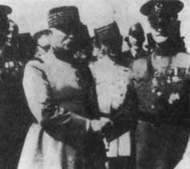
The Origins of Digital Image Processing
One of the first applications of digital images was in the newspaper industry, when pictures were first sent by submarine cable between London and New York (Bartlane cable).
- produced in 1921 (telegraph)
- five distinct levels of gray
- produced in 1922 (telegraph)
- after the signals had crossed the Atlantic twice
- produced in 1929 (telegraph)
- 15 distinct levels of gray

Slide 23
The Origins of Digital Image Processing
The history of digital image processing is intimately tied to the development of the digital computer

Slide 24
Cont.,
The first computers powerful enough to carry out meaningful image processing tasks appeared in the early 1960s.
- In 1964 when pictures of the moon transmitted by Ranger 7.
- processed by a computer to correct various types of image distortion inherent in the on-board television camera.
ي عام 1964، قامت مركبة رينجر 7 بالتقاط ونقل صور للقمر. تم التقاط هذه الصور باستخدام كاميرا تلفزيونية موجودة على متن المركبة. ومع ذلك، كانت الصور التي تم استلامها من رينجر 7 تعاني من أنواع مختلفة من التشوهات في الصورة ناتجة عن عيوب الكاميرا وأخطاء النقل.
لتصحيح هذه التشوهات وتحسين جودة الصور، تم استخدام تقنيات معالجة الصور عن طريق الحاسوب. تم تحويل الصور إلى تنسيق رقمي وإدخالها إلى نظام حاسوبي، حيث تم استخدام خوارزميات وبرامج لأداء تصحيح وتحسين الصور.

Slide 25
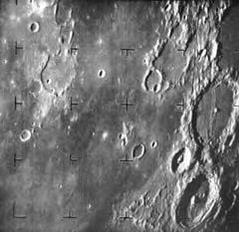

Slide 26
Image Types
Image types according to color :
1-color RGB
2-Binary
3-gray

Slide 27
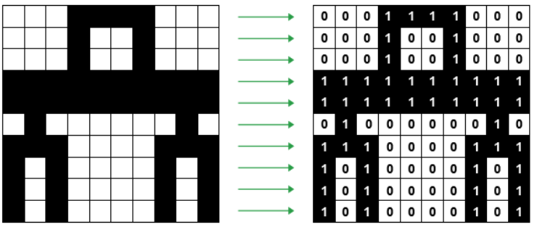
Binary image

Slide 28

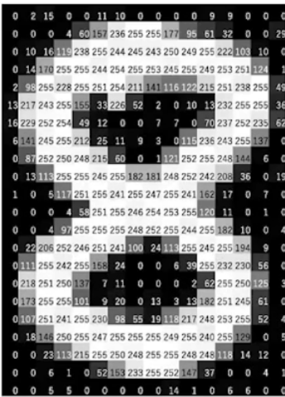
gray image

Slide 29
RGB Image

Slide 30
Image Types
Image types according to energy source:
1- Electromagnetic energy spectrum images(لصور الخاصة بطيف الطاقة الكهرومغناطيسية هي صور تلتقط مجموعة متنوعة من الموجات أو الترددات ضمن طيف الطاقة الكهرومغناطيسية. يشمل طيف الطاقة الكهرومغناطيسية مجموعة واسعة من الطاقة، بدءًا من الموجات الراديوية ذات التردد المنخفض إلى الأشعة الغاما ذات الطاقة العالية. )
2- Acoustic & ultrasonic images( الصور الطبية التي تتم إنشاؤها باستخدام الموجات فوق الصوتية. تستخدم هذه التقنية الموجات فوق الصوتية لإنشاء صور داخلية للأنسجة والأعضاء في الجسم.)
3- Electronic images(لصور الإلكترونية هي صور تم إنشاؤها أو تخزينها بواسطة أجهزة إلكترونية وتكنولوجيا الحوسبة. )
4- Computer modeling images (الرسام )

Slide 31
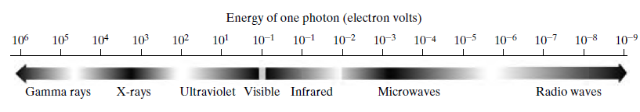
Electromagnetic spectrum (EM)
Electromagnetic waves are sinusoidal waves of varying wavelengths, or are a stream of massless particles, each traveling in a wavelike pattern and moving at the speed of light.
Each massless particle contains a certain amount (or bundle) of energy (photon)

Slide 32
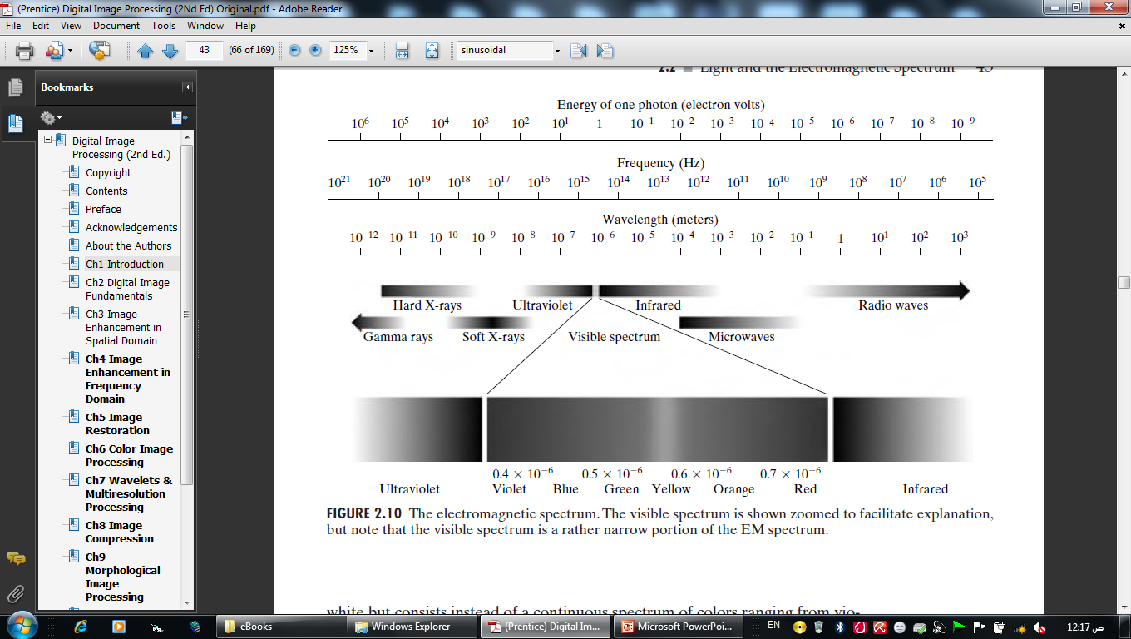
Electromagnetic spectrum (EM)

Slide 33
light
Light is a form of electromagnetic radiation that is visible to the human eye and can travel through both vacuum and material mediums. It is part of the electromagnetic spectrum, which includes various types of radiation such as infrared, ultraviolet, X-rays, and gamma rays
0.43 micron (violet) to about 0.79 micron (red).
violet, blue, green, yellow, orange, and red

Slide 34
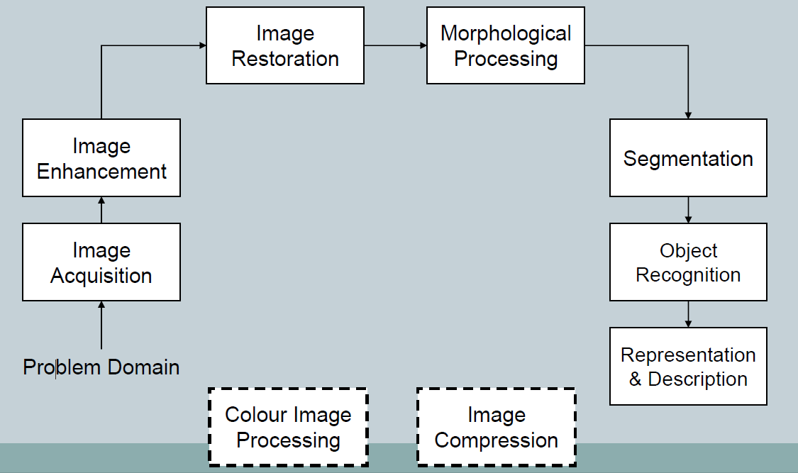
Fundamental steps in digital image processing.

Slide 35
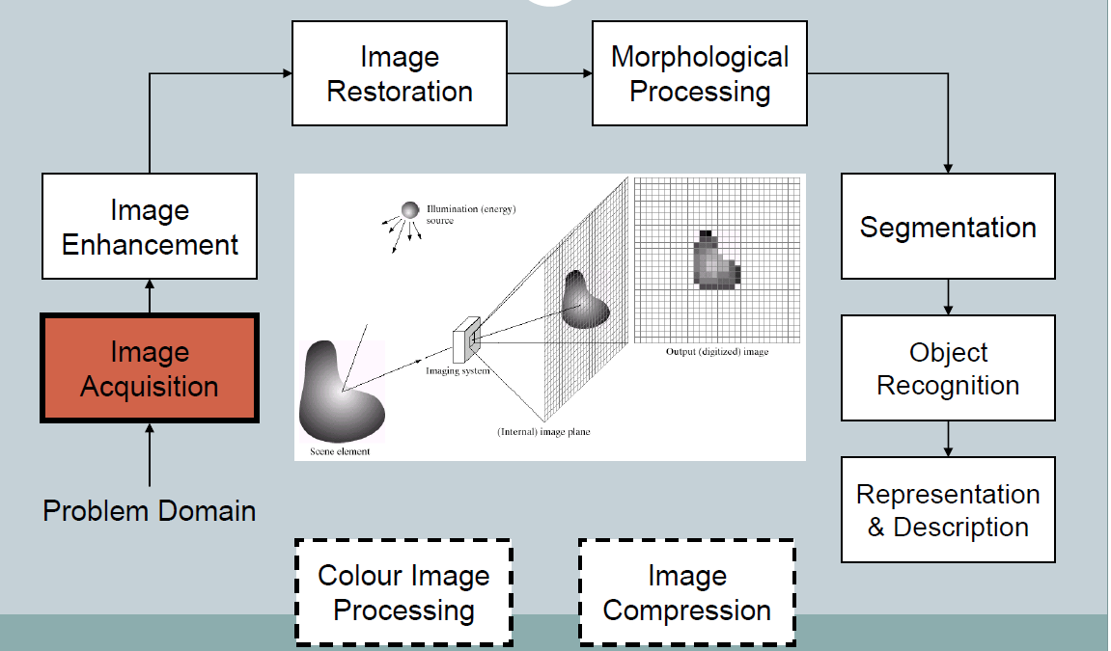
Fundamental steps in digital image processing.

Slide 36
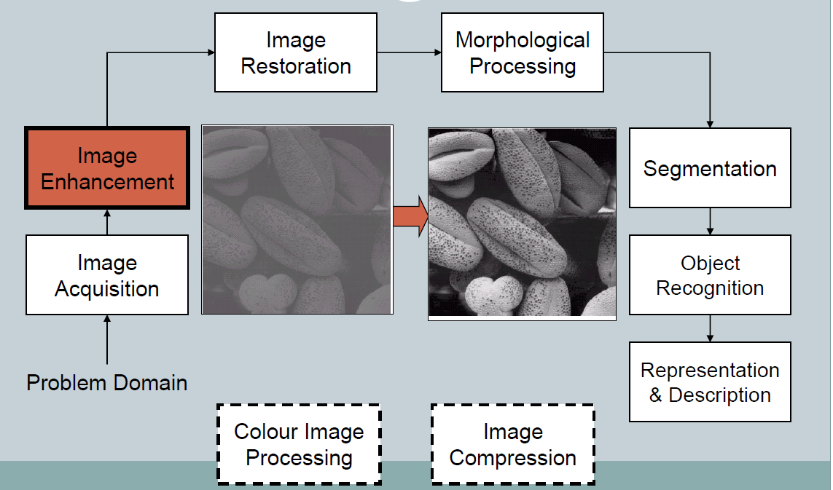
Fundamental steps in digital image processing.

Slide 37
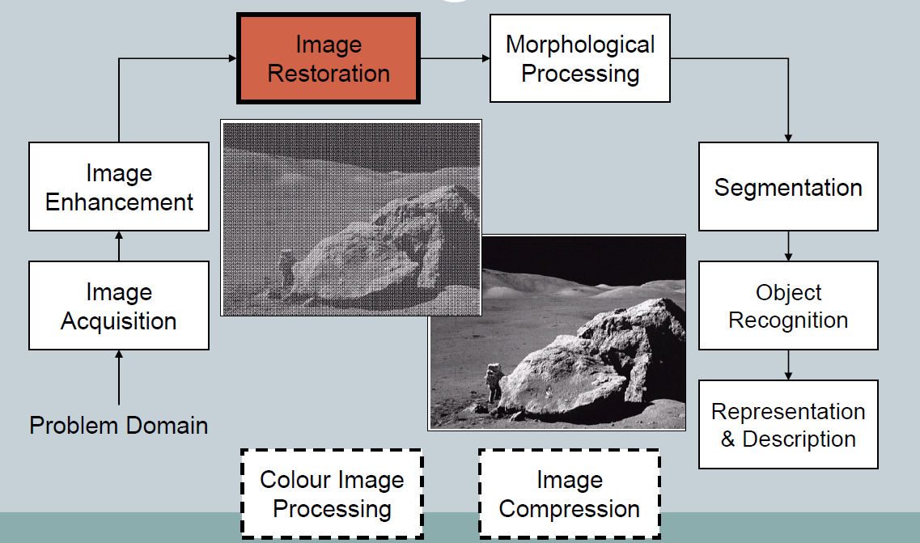
Fundamental steps in digital image processing.

Slide 38
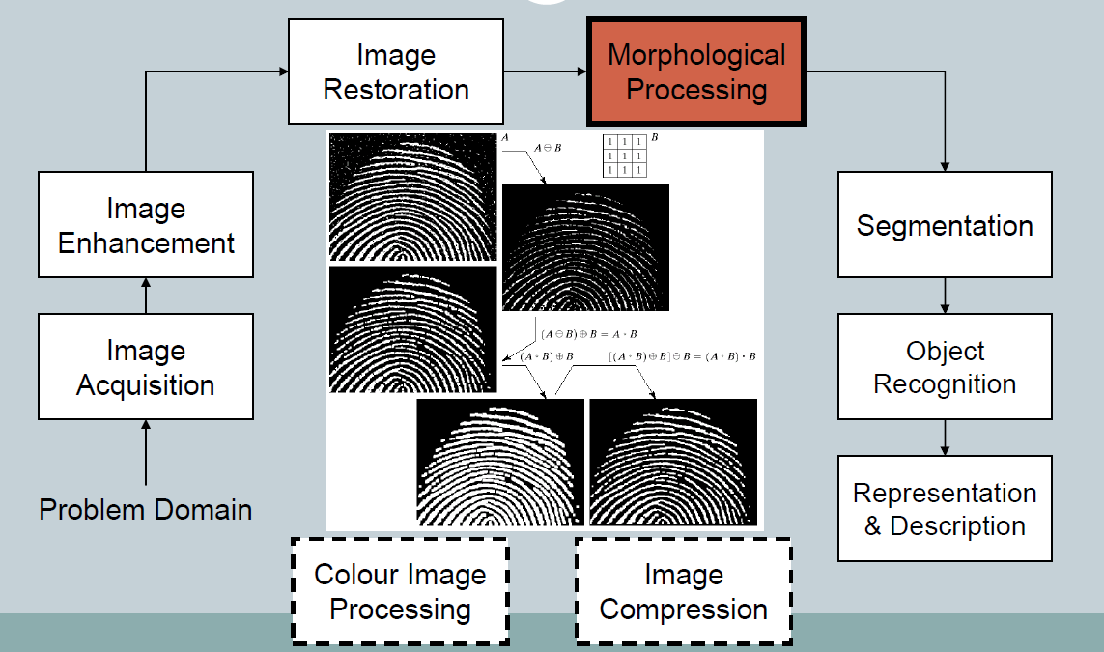
Fundamental steps in digital image processing.

Slide 39
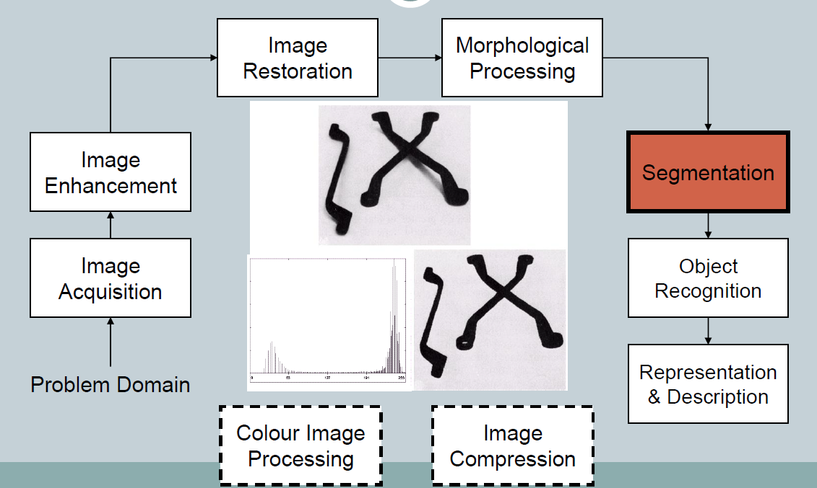
Fundamental steps in digital image processing.

Slide 40
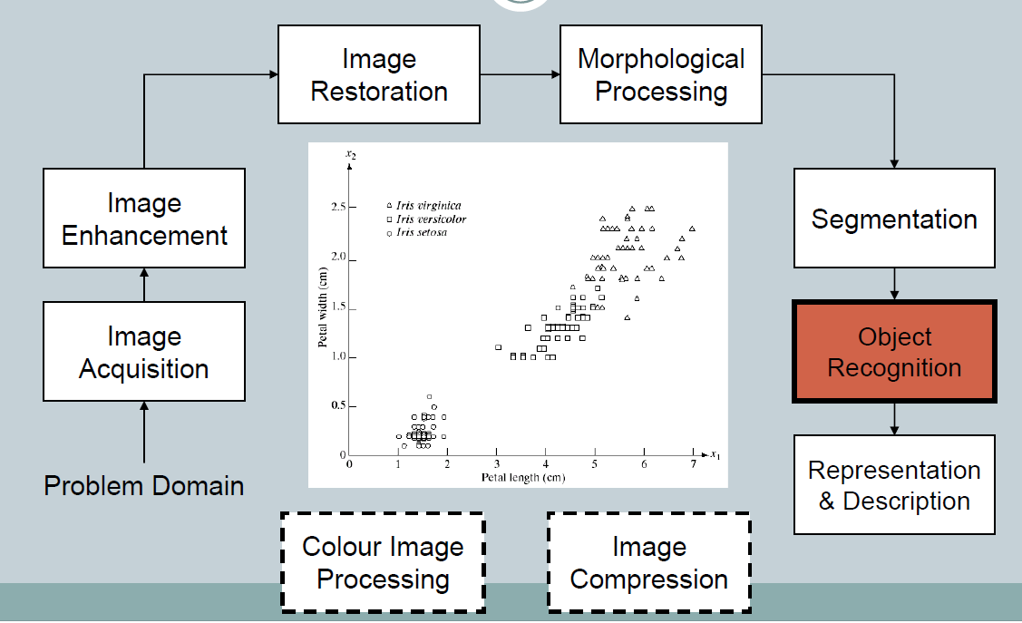
Fundamental steps in digital image processing.

Slide 41
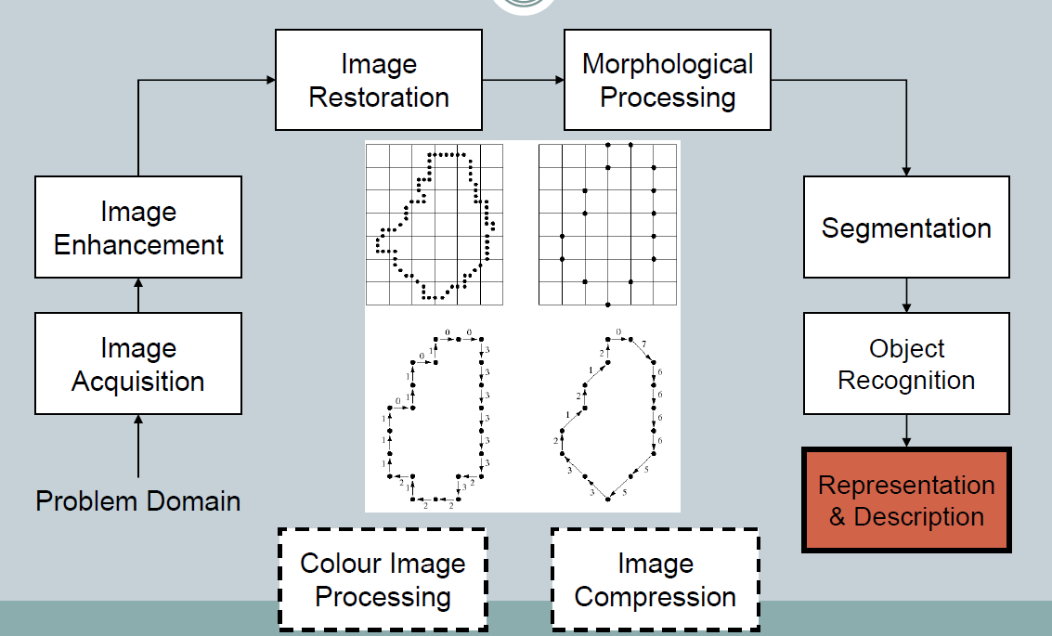
Fundamental steps in digital image processing.

Slide 42
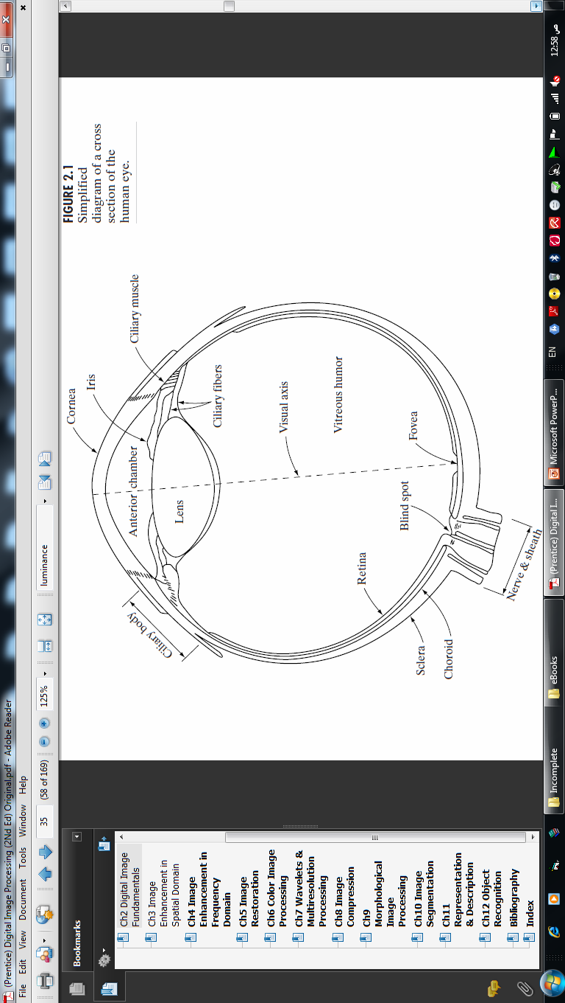
Elements of Visual Perception 1.Structure of the Human Eye
E
Retina:(2 receptors)
- Cones (6 – 7 million) بكسل الجوال
- Rods (75 to 150 million)
*photopic or bright-light vision
scotopic or dim-light vision
Notes:
شبكية العين تتكون من مستقبلين هما :
- المخاريط
(6 – 7 million)
* رؤية ضوئية أو ضوء ساطع.
- عصي
(75 to 150 million)
* رؤية ظلامية أو رؤية ضوء خافت.

Slide 43
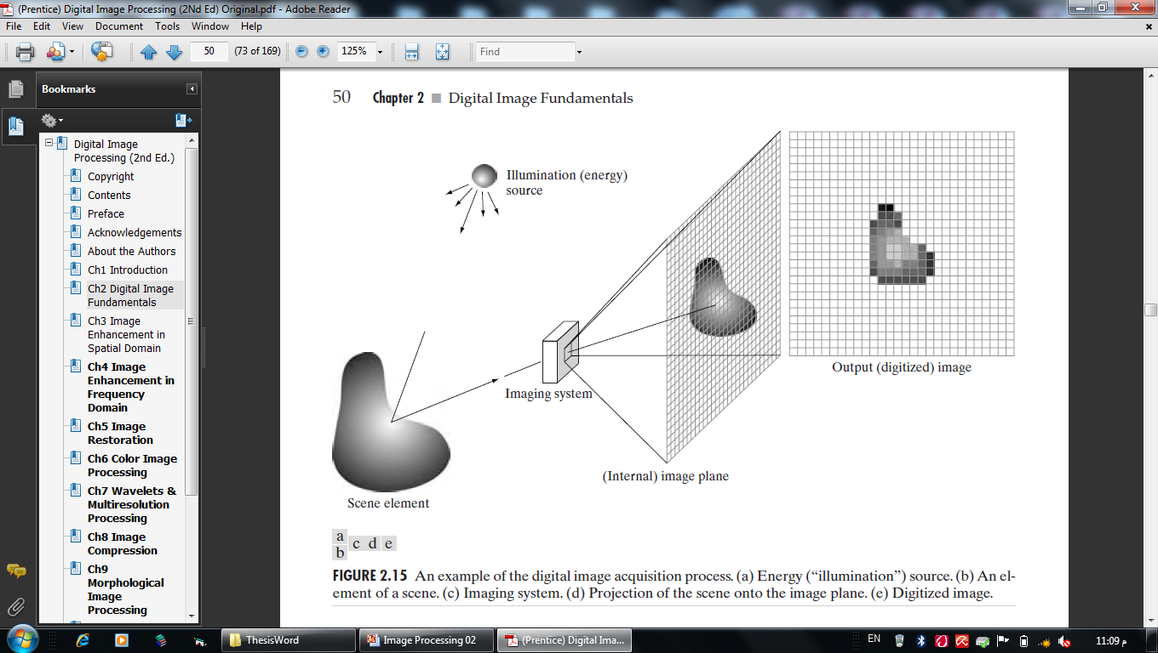
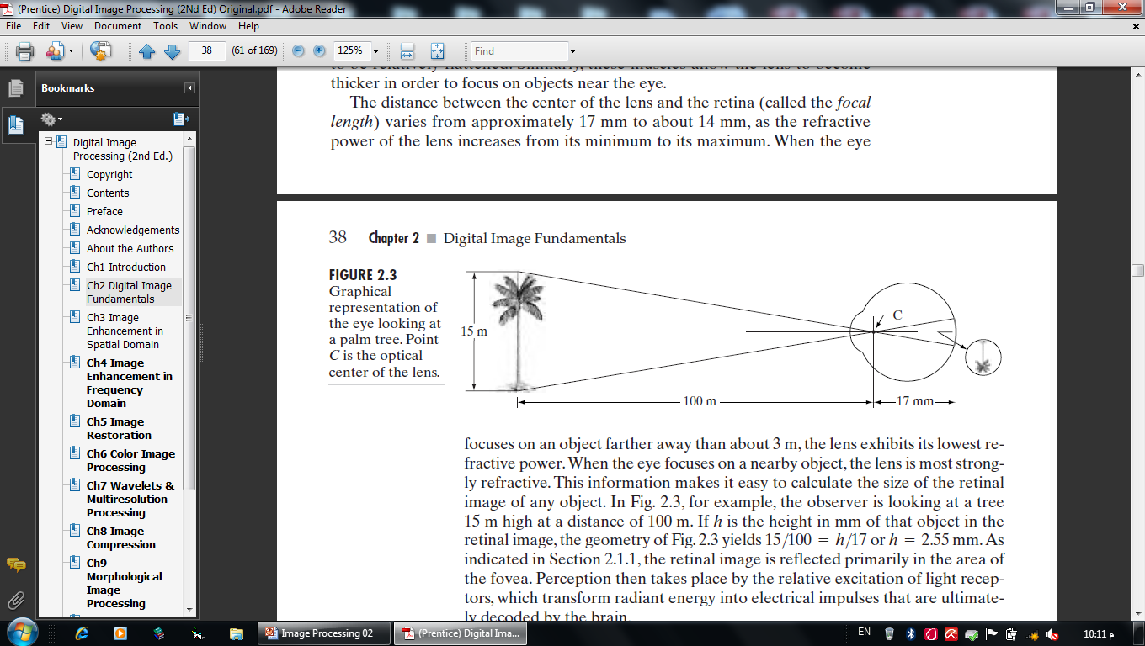
Image Formation in the Eye

Slide 44
What determines image quality?
(Achromatic or monochromatic) and chromatic light.
Three basic quantities are used to describe the quality of a chromatic light source: radiance; luminance; and brightness.
Radiance
is the total amount of energy that flows from the light source, and it is usually measured in watts.
Luminance,
measured in lumens (lm), gives a measure of the amount of energy an observer perceives from a light source.
Brightness
Brightness is a subjective perception of light intensity by the human visual system. It is the attribute of visual perception that determines the subjective impression of how intense a light source or a surface appears. Brightness can be influenced by various factors, including the luminance of the light source or surface, the surrounding environment, and individual differences in visual perception. Brightness is often described using qualitative terms such as "bright," "dim," or "dull.«في الحاسوب ناخذ تدرج اللون لكل نقطه

Slide 45
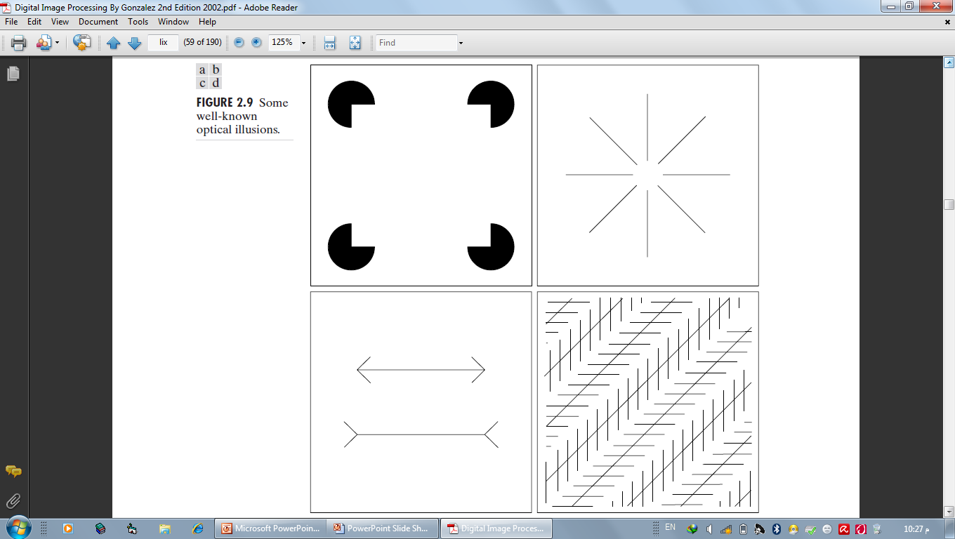
Some well known optical illusions بعض الخداع البصري المعروف

Slide 46
Some well known optical illusions simultaneous contrast

Slide 47
Next
Image Sensing and Acquisition استشعار الصورة والحصول عليها

Slide 48
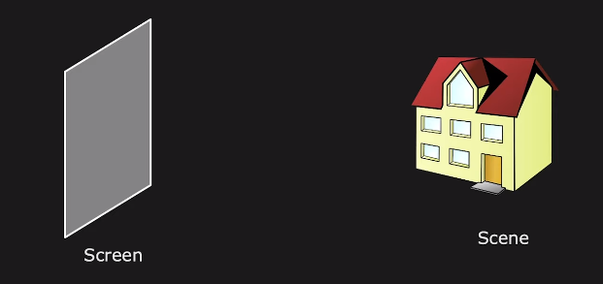
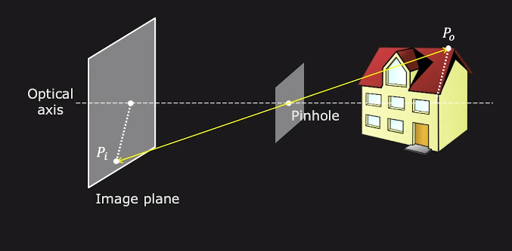
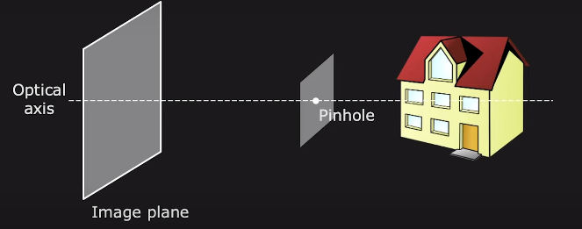
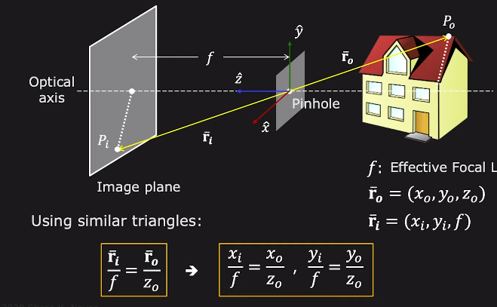
Pinhole projection

Slide 49
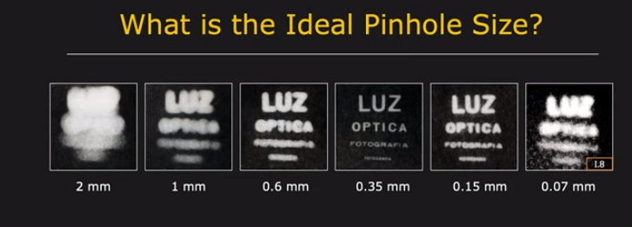

Slide 50
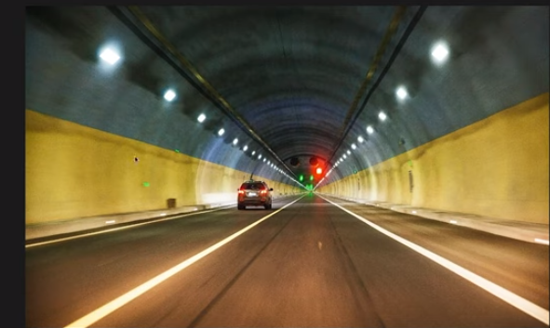
Notes:
ايش اسم النقطه
ما السبب

Slide 51
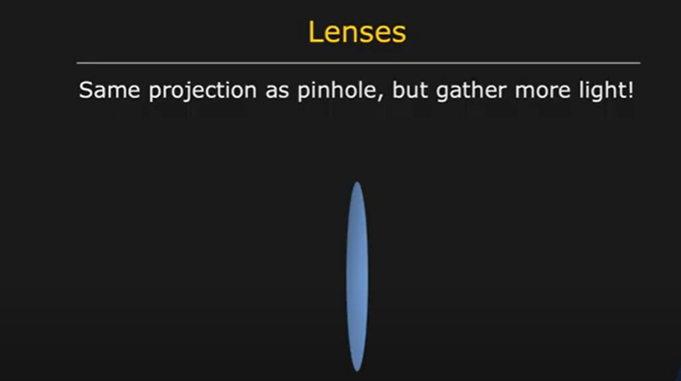

Slide 52
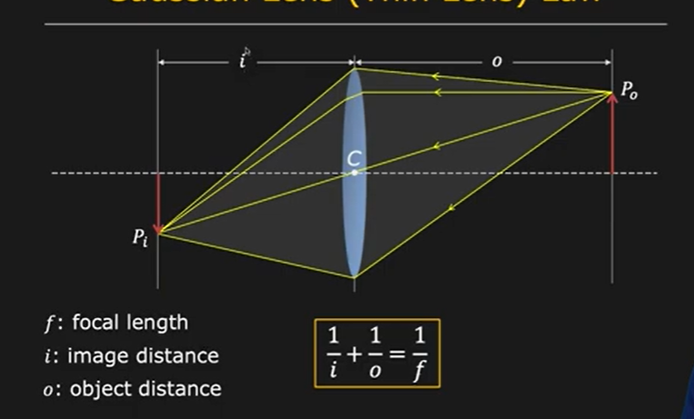

Slide 53
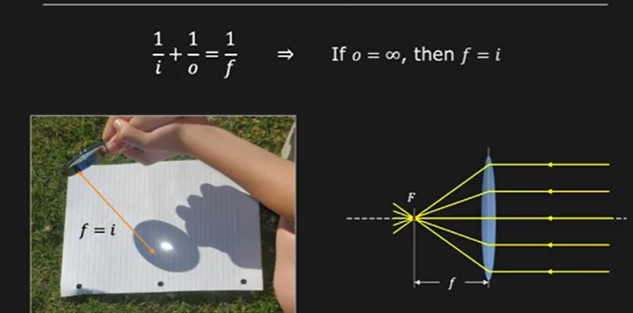

Slide 54
Image Sensing and Acquisition
Image Sensing and Acquisition There are 3 principal sensor arrangements (produce an electrical output proportional to light intensity). (i)Single imaging Sensor (ii)Line sensor (iii)Array sensor

Slide 55
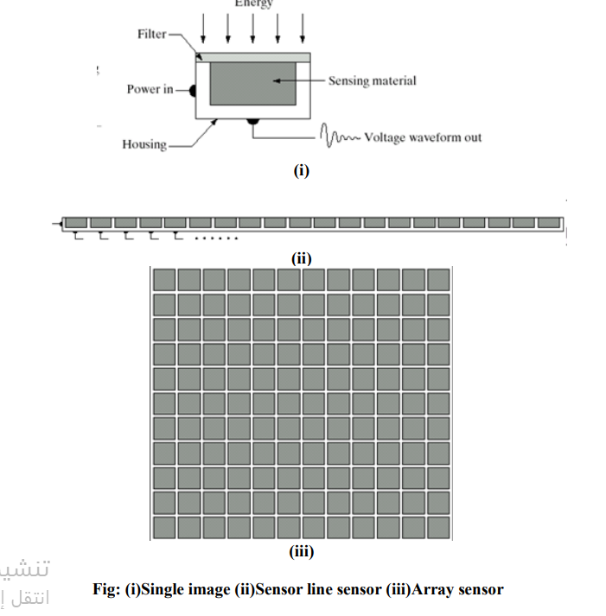
Image Sensing and Acquisition

Slide 56
Image Sensing and Acquisition
1.Image Acquisition Using a Single Sensor.
2.Image Acquisition Using Sensor Strips 3. Image Acquisition Using Sensor Arrays

Slide 57
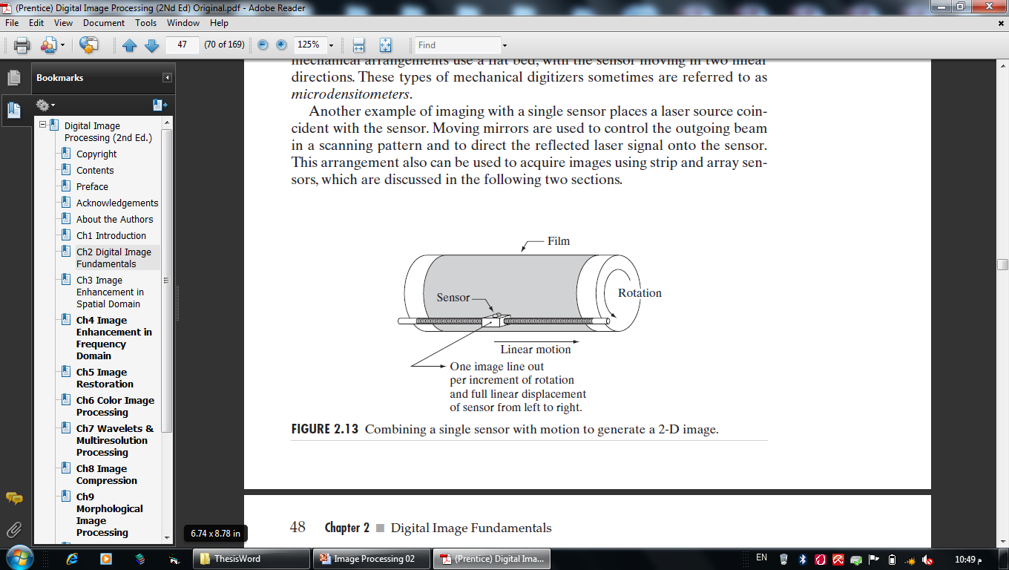
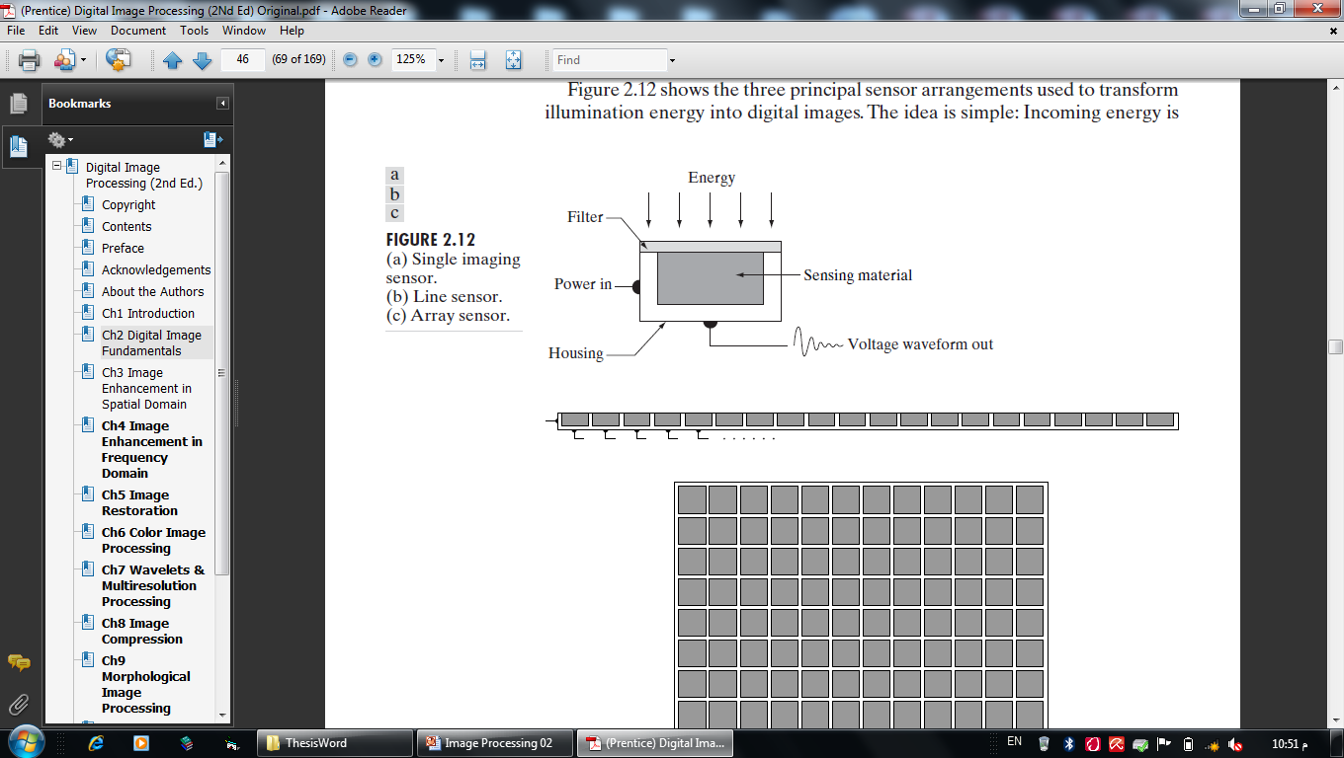
1.Image Acquisition Using a Single Sensor
In order to generate a 2-D image using a single sensor, there have to be relative displacements in both the x- and y-directions between the sensor and the area to be imaged. An arrangement used in high precision scanning, where a film negative is mounted onto a drum whose mechanical rotation provides displacement in one dimension. The single sensor is mounted on a lead screw that provides motion in the perpendicular direction. Since mechanical motion can be controlled with high precision, this method is an inexpensive (but slow) way to obtain high-resolution
images.

Slide 58
1.Image Acquisition Using a Single Sensor
من أجل إنشاء صورة ثنائية الأبعاد باستخدام مستشعر واحد، يجب أن تكون هناك إزاحات نسبية في كلا الاتجاهين x وy بين المستشعر والمنطقة المراد تصويرها. وهو ترتيب يستخدم في المسح الضوئي عالي الدقة، حيث يكون الفيلم سلبيًا يتم تركيبه على أسطوانة يوفر دورانها الميكانيكي إزاحة في بُعد واحد. يتم تثبيت المستشعر الفردي على برغي رئيسي يوفر الحركة في الاتجاه العمودي. وبما أنه يمكن التحكم في الحركة الميكانيكية بدقة عالية، فإن هذه الطريقة تعتبر طريقة غير مكلفة (ولكنها بطيئة) للحصول على دقة عالية
الصور.

Slide 59
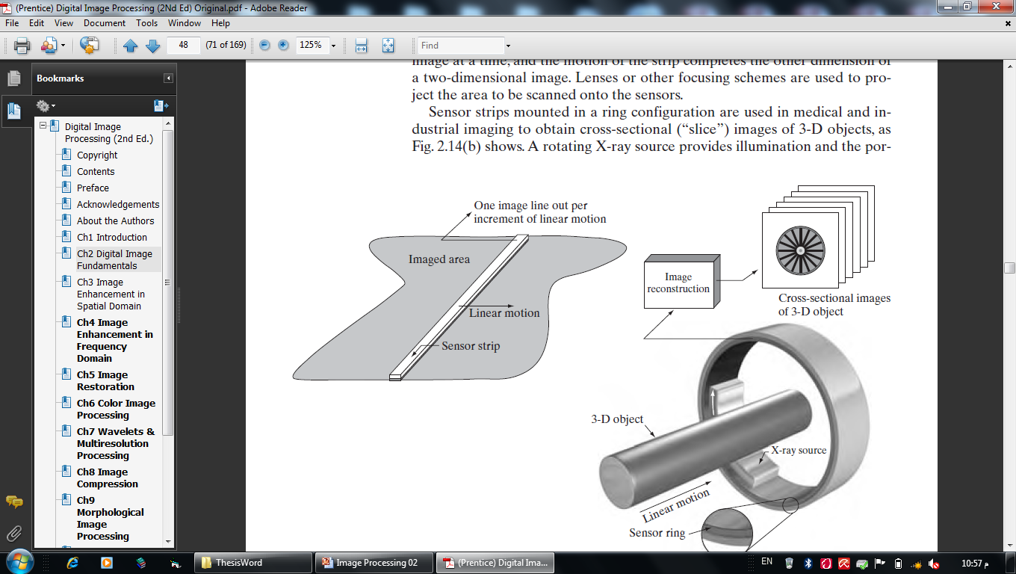
2.Image Acquisition Using Sensor Strips
عملية الحصول على الصور باستخدام شرائح الاستشعار تشير إلى عملية التقاط الصور باستخدام مجموعة خطية من أجهزة الاستشعار المرتبة في شريط أو خط واحد. يتم استخدام هذا النهج بشكل شائع في أنظمة التصوير المختلفة، بما في ذلك الماسحات الضوئية المسطحة وتطبيقات التصوير الجوي والتصوير الطبي والصناعي.
في حالة الماسحات الضوئية المسطحة، يتم استخدام شريط استشعار واحد لمسح الوثيقة أو الصورة. يتكون الشريط الاستشعار من مجموعة خطية من أجهزة الاستشعار الحساسة للضوء. يتم وضع الوثيقة أو الصورة على سطح الماسح الضوئي، ويتحرك الشريط الاستشعار عبر الوثيقة، مع التقاط الصورة سطراً بسطر.
وفي حالة التطبيقات الجوية، يتم استخدام أشرطة استشعار خطية للاستجابة لمختلف نطاقات الطيف الكهرومغناطيسي، وتركيبها عمودياً على اتجاه الطيران الثابت للحصول على صورة للمنطقة الجغرافية المستهدفة. تعطي شريط الاستشعار سطرًا واحدًا من الصورة في كل مرة، وتكتمل البُعدين الآخرين للصورة ثنائية الأبعاد بحركة الشريط.

Slide 60
Image Acquisition Using Sensor Arrays
تم العثور على هذا النوع من الترتيب في الكاميرات الرقمية. المستشعر النموذجي لهذه الكاميرات هو مصفوفة CCD، والتي يمكن تصنيعها بنطاق واسع من خصائص الاستشعار ويمكن تعبئتها في مصفوفات متينة مكونة من 4000 * 4000 عنصر أو أكثر. تُستخدم مستشعرات CCD على نطاق واسع في الكاميرات الرقمية وأدوات استشعار الضوء الأخرى. تتناسب استجابة كل مستشعر مع تكامل الطاقة الضوئية المسقطة على سطح المستشعر، وهي خاصية تستخدم في التطبيقات الفلكية وغيرها من التطبيقات التي تتطلب صورًا منخفضة الضوضاء.

Slide 61
A Simple Image Formation Model
An image is a two-dimensional function of the form f(x, y). f(x, y) must be nonzero and finite
0 < f(x,y) < infinit
f(x, y) may be characterized by two components: (1) the amount of source illumination incident on the scene being viewed, and (2) the amount of illumination reflected by the objects in the scene. Appropriately, these are called the illumination and reflectance.
f(x, y)=i(x, y)r(x, y)

Slide 62
A Simple Image Formation Model
0 < i(x,y) < infinite
0 < r(x,y) < 1
gray level (l) : f(x0,y0)=l
Lmin <l< Lmax
Lmin=imin*rmin
Lmax=imax*rmax
Gray scale : [Lmin,Lmax] and shifted to [0,L-1]

Slide 63
Image Sampling and Quantization

Slide 64
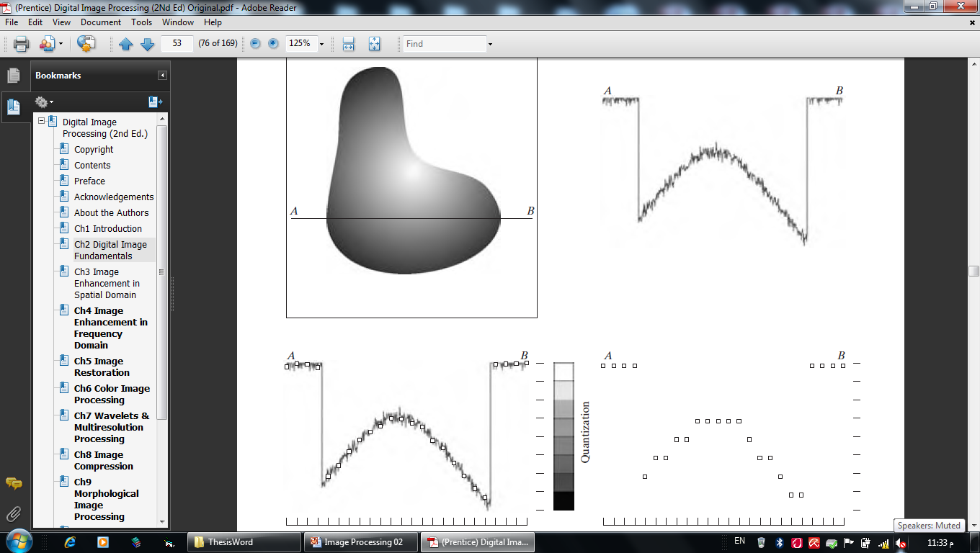
Image Sampling and Quantization

Slide 65
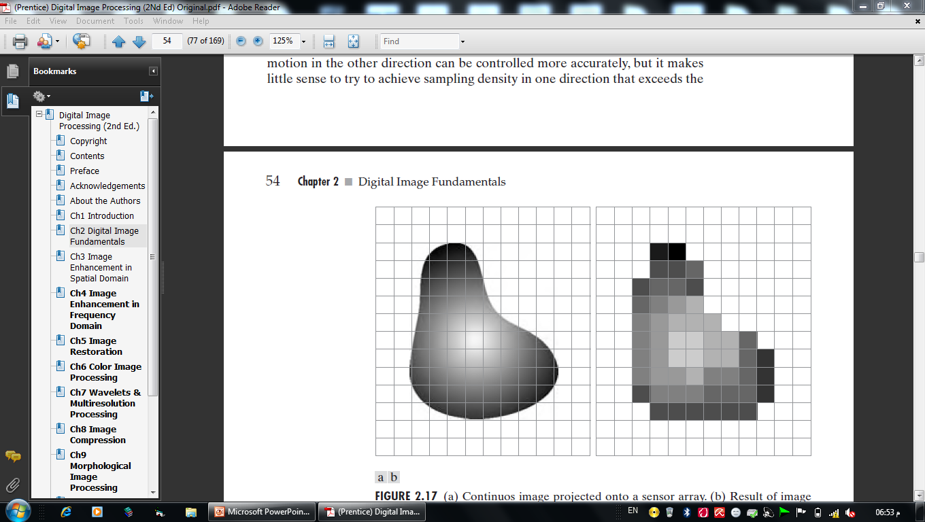
Image Sampling and Quantization

Slide 66
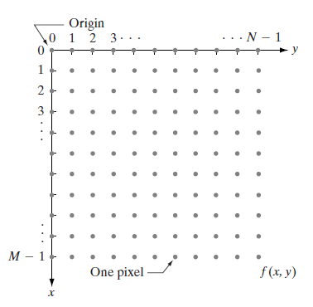
An image f(x, y) is sampled so that the resulting digital image has M rows and N columns. The values of the coordinates (x, y) now become discrete quantities. Thus, the values of the coordinates at the origin are (x, y)=(0, 0). The next coordinate values along the first row of the image are represented as (x, y)=(0, 1)
Representing Digital Images

Slide 67
This digitization process requires decisions about values for M, N, and for the number, L, of discrete gray levels allowed for each pixel (M ,N and L are positive integers). Due to processing, storage, and sampling hardware considerations, the number of gray levels typically is an integer power of 2: L = 2^{k} The Gray levels is in the interval [0,L-1]. Dynamic range of an image : the range of values spanned by the gray scale. (high dynamic range)
Representing Digital Images

Slide 68
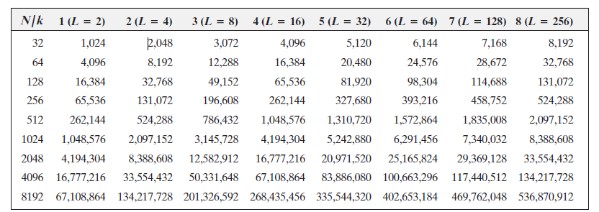
The number, b, of bits required to store an image is : b = M x N x K When M=N : b = N² K We have 4-bits, 8-bits , …, images.
Representing Digital Images

Slide 69
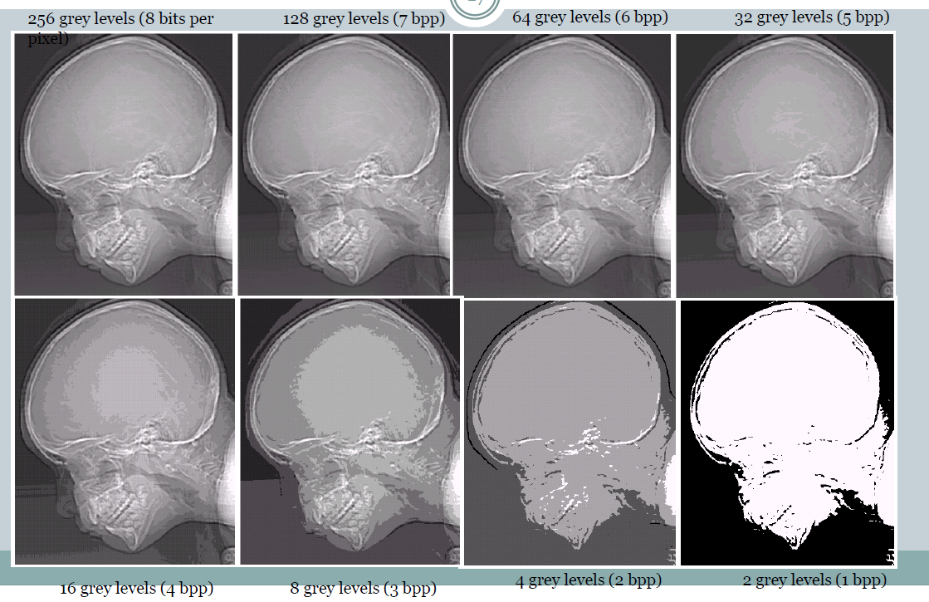
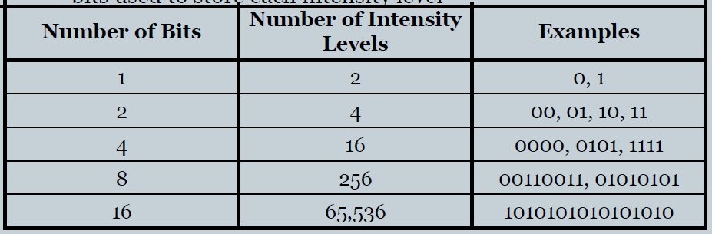
Representing Digital Images

Slide 70
Spatial and Gray-Level Resolution
Sampling is the principal factor determining the spatial resolution of an image.
Spatial resolution is the smallest discernible detail in an image.
Or, it is simply the smallest number of discernible line pairs per unit distance; for example, 100 line pairs per millimeter.
Gray-level resolution refers to the smallest discernible change in gray level.
أصغر تغيير يمكن تمييزه في مستوى الرمادي.

Slide 71
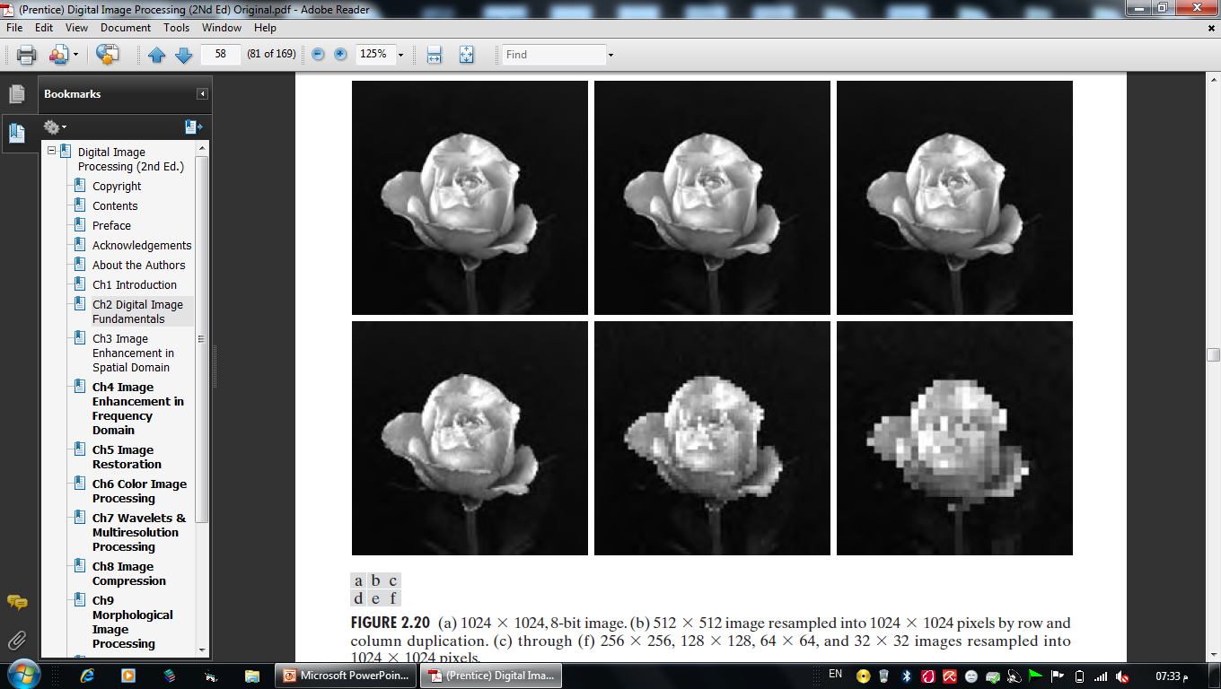
Spatial and Gray-Level Resolution

Slide 72
Zooming and Shrinking Images

Slide 73
Zooming and Shrinking Images
Zooming requires two steps: the creation of new pixel locations, and the assignment of gray levels to those new locations.
Simple method is Pixel replication. It is used when we want to increase the size of an image an integer number of times (Exp 2,3,..).
Pixel interpolation such as nearest neighbor interpolation. It is used when we want to increase the size of an image real number of times (Exp 1.3,2.3,..).
bilinear interpolation is another kind of Pixel interpolation and the best.

Slide 74
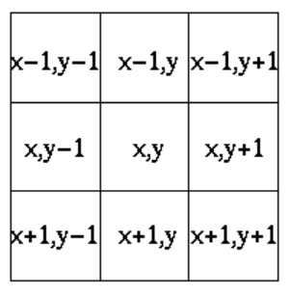
Some Relationships Between Pixels
Neighbors of a Pixel :
(4-neighbors) of a pixel p at coordinates (x, y) have coordinates : (x+1, y), (x-1, y), (x, y+1), (x, y-1).
(4-diagonal neighbors) : have coordinates
(x+1, y+1), (x+1, y-1), (x-1, y+1), (x-1, y-1)
4-diagonal neighbors together with the 4-neighbors, are called the 8-neighbors of p.

Slide 75
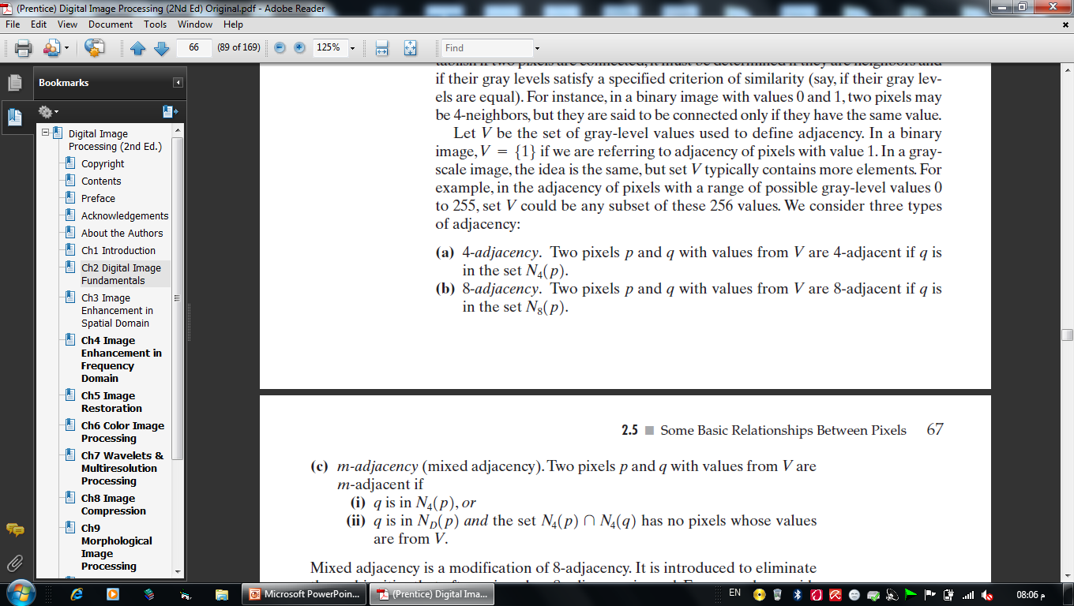
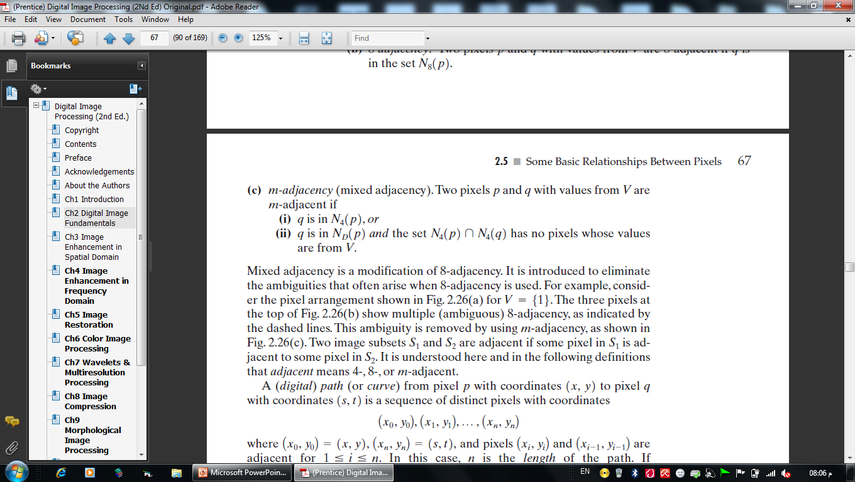
Some Relationships Between Pixels
Neighboring Connectivity:
two pixels are connected if they are neighbors and if their gray levels satisfy a specified criterion of similarity.تفي بمعيار محدد
Adjacency: let V a sub set of [0,L-1]

Slide 76
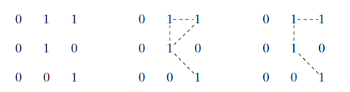
Some Relationships Between Pixels
Adjacency:
Path : A (digital) path (or curve) from pixel p with coordinates (x, y) to pixel q with coordinates (s, t) is a sequence of distinct pixels with coordinates:
(x₀ , y₀), (x₁ , y₁), … , (x_{n} , y_{n})
According to one of the adjacency types.

Slide 77
Some Relationships Between Pixels
Connectivity in a region :
Let S represent a subset of pixels in an image. Two pixels p and q are said to be connected in S if there exists a path between them consisting entirely of pixels.
Connected Set:
For any pixel p in S, the set of pixels that are connected to it in S is called a connected component. If it only has one connected component, then set S is called a connected set

Slide 78
Some Relationships Between Pixels
Region:
Let R be a subset of pixels in an image. We call R a region of the image if R is a connected set.
Boundary (also called border or contour):
A boundary of a region R is the set of pixels in the region that have one or more neighbors that are not in R.
Edge: is not closed path.

Slide 79
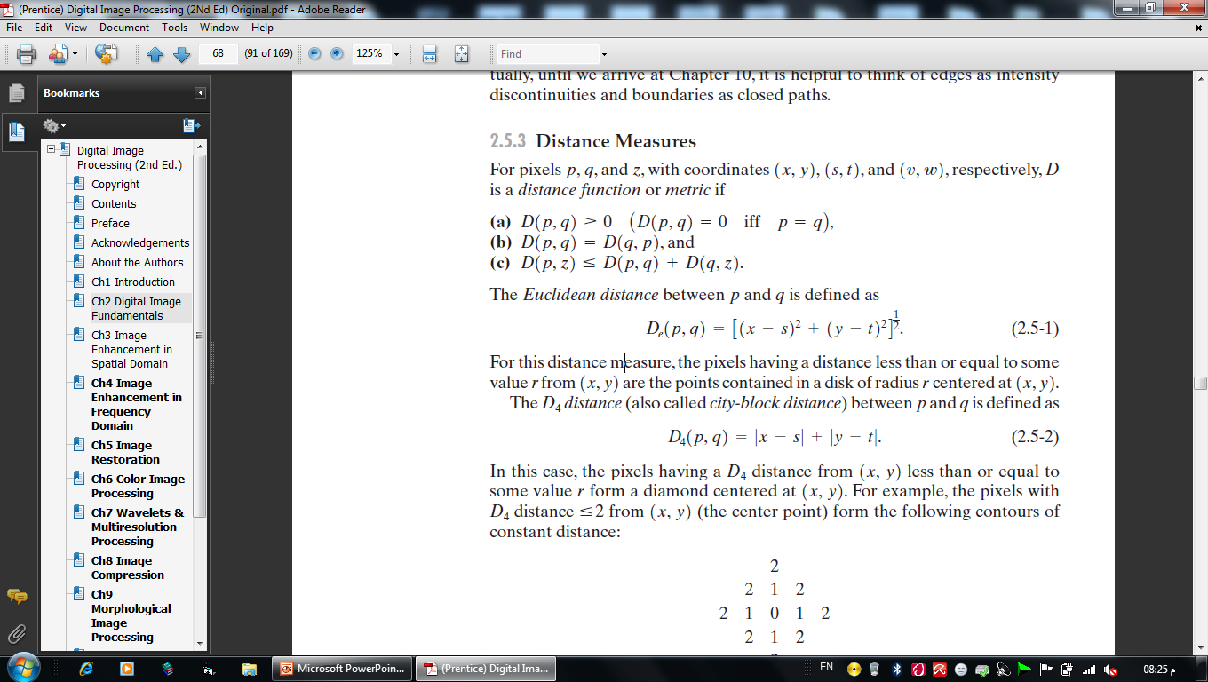
Distance Measures

Slide 80
Image Operations on a Pixel Basis
Division, addition, subtraction, …
arithmetic and logic operations are similarly defined between corresponding pixels in the images involved.

Slide 81
Image Operations on a Pixel Basis

Slide 82
Image Operations on a Pixel Basis

Slide 83
Image Operations on a Pixel Basis
Four arithmetic operation are denoted as:

Images in arithmetic operations must be of the same size.

Slide 84
Logical operations

Slide 85
Averaging noisy images for noise reduction

Slide 86
Averaging noisy images for noise reduction

Slide 87
Note:
In arthmetic operations such as difference between two 8-bit images can range from a min. Of -255 and a max. Of 255 ,and the values of sum two images can range from 0 to 510.
So we need to set all negative values to 0 and set to 255 all values exceed this limit.

Slide 88
Spatial operations
Spatial operations are performed directly on the pixels of a given image.
Point : the output value at a specific coordinate is dependent only on the input value at that same coordinate.
Local : the output value at a specific coordinate is dependent on the input values in the neighborhood of that same coordinate
Global : the output value at a specific coordinate is dependent on all the values in the input image

Slide 89
Spatial operations

Slide 90
Image Enhancement

Slide 91
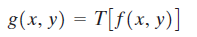
Image Enhancementin the Spatial Domain
The term spatial domain refers to the aggregate of pixels composing an image.
Spatial domain methods are procedures that operate directly on these pixels. denoted by
where f(x, y) is the input image, g(x, y) is the processed image, and T is an operator on f, defined over some neighborhood of (x, y).

Slide 92
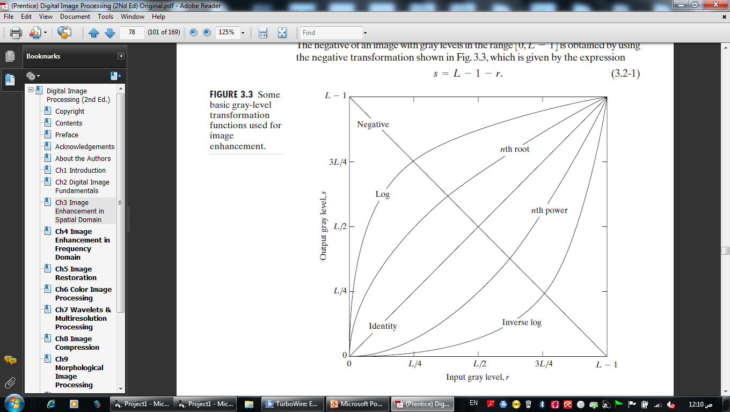
Some Basic Gray Level Transformations
Image Negatives : The negative of an image with gray levels in the range [0,L-1]is obtained by: s = L – r - 1

Slide 93
Some Basic Gray Level Transformations
Log Transformations : maps a narrow range of low gray-level values in the input image into a wider range of output levels.
s = c log (1 + r)

Slide 94
Image Enhancement

